Slide 1
Town Meeting Orientation
Updated: May 4th, 2026
Jeff Alderson, Town Moderator

Slide 2
How to Prepare for Town Meeting
Educate yourself on the Finance Committee Recommendation Book. Read articles, motions, and details as well as any supplemental information provided.
Watch meetings and hearings of the Finance Committee and the Planning Board
Watch the Primer videos prepared by the Moderator, Town Administration, Committee Chairs, and Natick Pegasus.
Prepare questions that you may have in advance of sessions. Try to ask Town staff in advance for detailed information.
Have an opinion but be open to the discussions and questions you will hear. You are the voice of your precinct constituency and the citizenry of the entire Town.
Ask your friends and neighbors how they feel about any matter of the warrant.

Slide 3
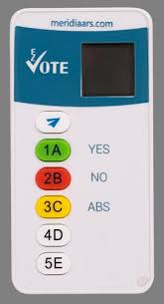
Upon Arriving Each Night of Town Meeting
Sign in with a member of the Town Clerks’ office who will ask name and precinct.
Members will receive their electronic device [aka Clicker] (assigned to each member), which are sorted by precinct and last name (alphabetical).
If a Member has a visual impairment, there are special electronic devices available.
Pick up additional printed information, that was not included in the TM Finance Committee Recommendations Book.
(Example Clicker)

Slide 4

Opening Ceremonies
Welcome Message and Introduction
Swearing in of Newly Elected Members
Invocation, Pledge of Allegiance, and Moment of Silence
Assembly of Town Meeting
Rules of Natick Town Meeting
Resolution(s) (if any)
Announcements (if any)

Slide 5

Rules and Procedures
Natick’s Town Meeting is governed primarily by four sets of rules:
Massachusetts General Laws
Town of Natick Charter
Town of Natick By-Laws
Town Meeting Time (4th Edition)
Other Rules may be adopted by Members as summarized and presented by the Moderator at the beginning of Town Meeting

Slide 6
Finance Committee Recommendations
The possible options for Finance Committee advisory recommendations mirrors Town Meeting votes and include:
Favorable Action - Recommendation to Town Meeting to approve Motion
Referral - Usually back to Sponsor and sometimes to Town Agency or other party
No Action - Can be construed as a no vote for Citizen Petitions
Indefinite Postponement - Usually construed as a negative action
No Recommendation - No majority vote for Motion is achieved

Slide 7
Consent Agendas
A consent agenda groups routine, non-controversial articles for a single vote, saving Town Meeting time.
Items typically have unanimous committee support and no expected debate.
The Moderator announces the list and asks if any member wishes to "hold" an item for separate discussion.
Seven (7) Town Meeting Members can rise and request removal.
If no articles are removed, the entire consent agenda is approved in one vote.

Slide 8
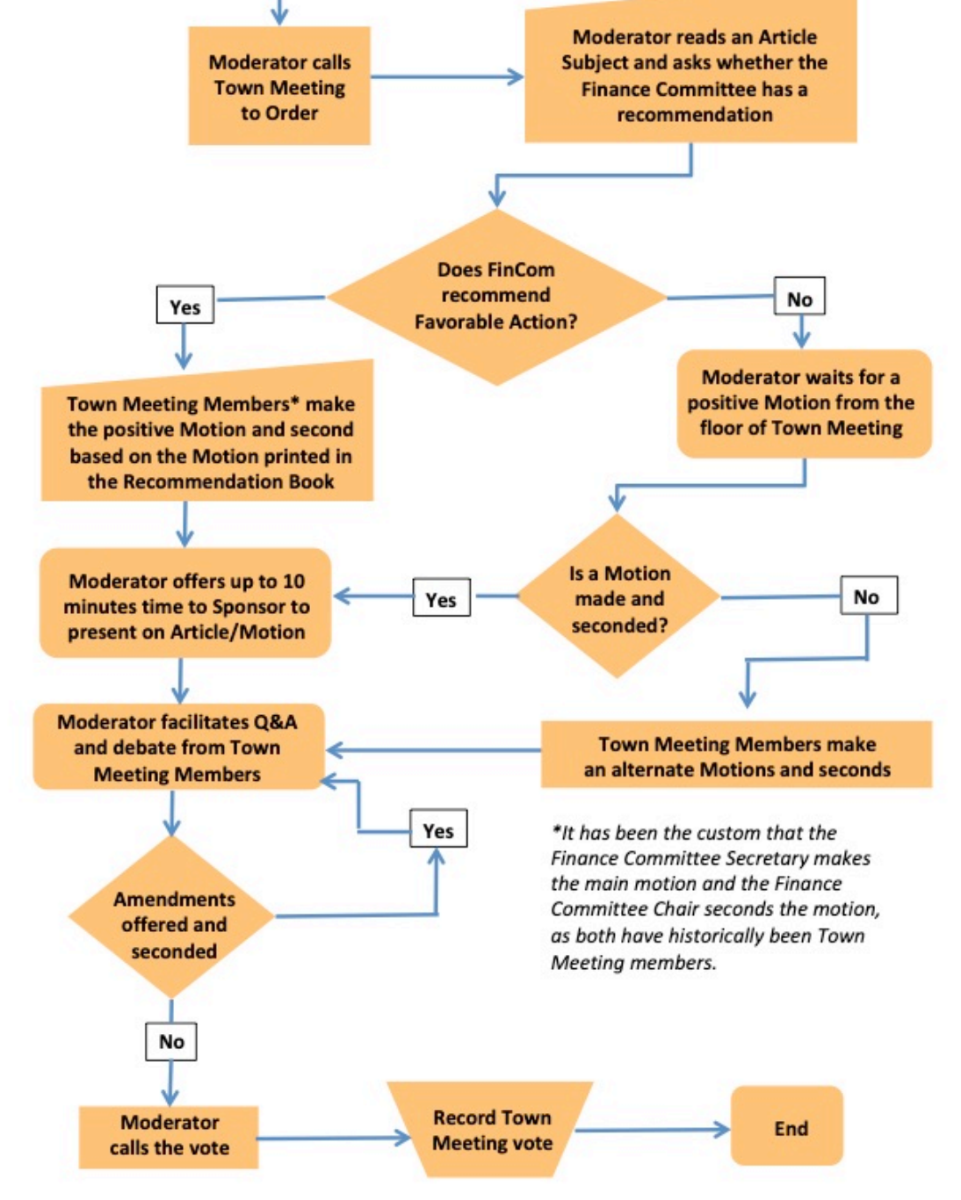


Typical Flow of a Warrant Article
Town Meeting averages 6-8 article decisions each session, more if a Consent Agenda is used

Slide 9
Making Motions and Amendments
Any town meeting member, and only a town meeting member, may make or second a motion. Motions must, in the opinion of the moderator, be within the scope of the warrant article under consideration.
Main Motions and any Amendments must be made in writing.
Complete the fillable PDF Motion template available on the Town Meeting website, OR…
Complete the Motion template included in the recommendation book
Submit the completed motion form to the Moderator by hand or email to: moderator@natickma.org
Main Motions MUST be submitted at least 48 hours in advance of each session.

Slide 10
Points of Order
“On a point of order, a voter may raise one or more of the following questions and no others:
Is the speaker entitled to the floor (for example, is the person a nonvoter, or a voter who has overstayed the time allotted by bylaw or the moderator’s guidelines)?
Is what the speaker is saying or proposing frivolous, irrelevant, illegal, or contrary to proper procedure?⁠3
Is any pending action frivolous, irrelevant, illegal, or contrary to proper procedure?”
– Section 7.2 in TMT 4

Slide 11
Other Motions
Motion to Refer: If approved, the subject matter of the article is referred to another agency or board for further consideration.
Motion to Close Debate (aka Move the Question): May be entertained by the moderator only if there are fewer than three people seeking recognition to speak for the first time on the matter at hand.
Motion to Reconsider: A motion to reconsider permits town meeting to rescind the action of a vote already taken during that town meeting and re-vote.
Questions of Privilege: Relate first to the conduct of the meeting: the “safety, dignity, and the integrity of its proceedings, and second to the rights, reputations and conduct of the voters or town meeting members individually, in their capacity as voters or members.
Point of No Quorum: Made when a town meeting member questions whether a quorum is still present.
Motions to Recess, to Adjourn to a Fixed Time, or to Fix the Time at Which to Adjourn
Motion to Dissolve: Only in order when every article in the warrant has been disposed of.

Slide 12
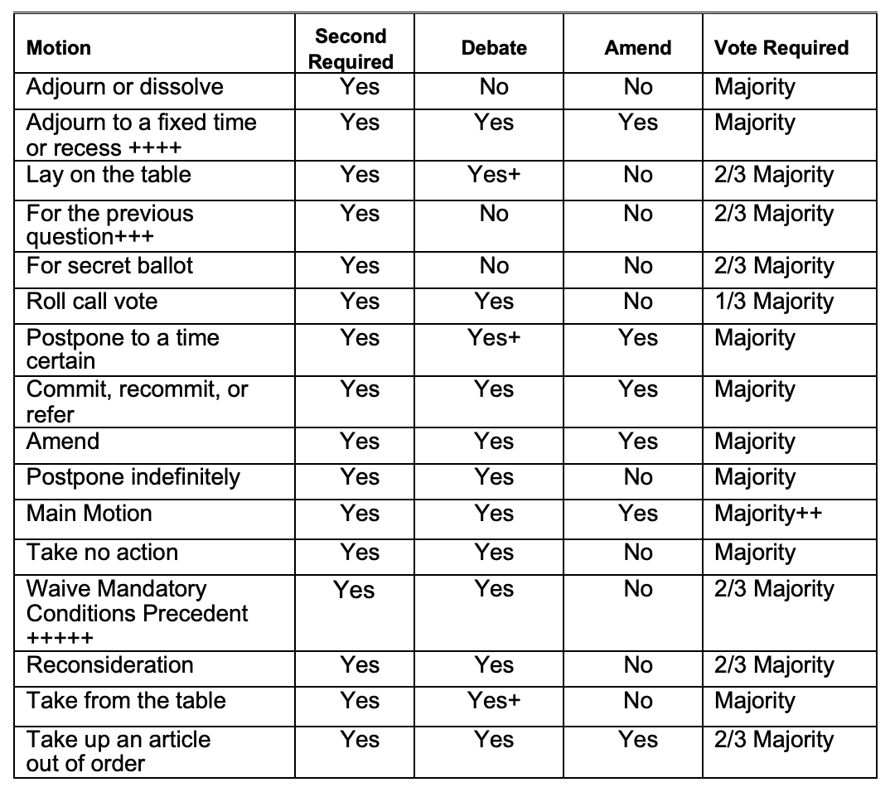
Precedence of Motions
When a question is before the town meeting, motions may be received and have precedence as listed in the table.
+ See By-Laws Article 3, Section 3
++ Some main motions are required by the general laws to be passed by greater than a majority vote; for example, bond issues, zoning changes, the taking of land require a 2/3 vote. For other examples, refer to the appendix in Town Meeting Time entitled "Quantum of Vote."
+++ See Bylaws Article 3, Section 11
++++ See By-Laws Article 1, Section 3
+++++ Finance Committee Public Hearing, see Bylaws Article 3, Section 1; Article 23, Section 4

Slide 13

Decorum in Debate
When recognized rise and either wait for a microphone to be brought to you or go to the podium.
State your name and precinct or other affiliation before proceeding.
Speakers do not speak directly to or ask questions of one another or to a proponent or official, but only to and through the moderator, as in, “Through you, Mr. Moderator.”
Speakers do not refer to others present at the meeting by name, but by title, or by designations such as “the previous speaker.”
Speaking ad hominem, that is, commenting on the arguers rather than their arguments, is known in town meeting as “indulging in personalities,” and is not permitted; nor are superfluous speeches, indecent language, or other incivilities.

Slide 14
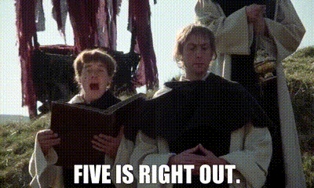
Making the Most of Your (Town Meeting) Time
Prepare your questions in advance after reviewing the motions, finance committee hearing minutes, and sponsor presentations.
Ask questions first, then enter into debate. Try to separate your questions, or the moderator will separate them for you.
If you exhaust your three questions, ask fellow members to use their time to ask additional questions.
After your initial debate, listen attentively to other speakers.
You have the option to speak a second time if no one is seeking the floor for the first time.

Slide 15
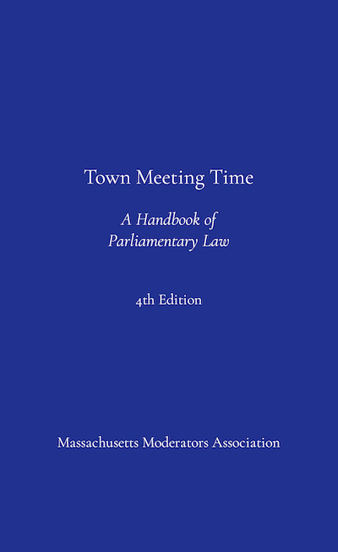
Town Meeting Member Resources
Town Moderator webpage
Rules & Procedures
Charter & Bylaws
Town Meeting webpage
Nightly agendas
Supporting materials
Motions and amendments
Contact info for Members
Finance Committee website
Recommendation Book
Detailed budget discussion
Town Meeting Notifications & Alerts
Email and text alerts
Notifications of agendas
Town Meeting Time (4th Edition)
Check Library for copies
Order the correct edition

Slide 16
Town Moderator Contact Information
Email: moderator@natickma.org
Phone: 508-810-7530
Calls, Texts, and Voicemails welcome!
I do NOT (and will NOT) use social media, with the exception of LinkedIn

